Slide 1

Our Team and Key Strengths
Diverse Academic Backgrounds
(Psychology, Animation Design, Hotel Management, UX Research)
Strong User Research Skills
(Deep user interviews, understanding needs)
Art Design & Visual Presentation Expertise
(Animation design, color matching)
Technical Skills in Web Design
(HTML, CSS, JavaScript)
Industry Experience in Service Management
(Real-life scenario solutions)
Teamwork & Collaboration
(Active participation, shared knowledge)
Notes:
Hello everyone, now I am going to introduce our team and share our main strengths. Our team is made up of members from different academic backgrounds, including psychology, animation design, hotel and tourism management, and user experience research. These diverse backgrounds give us a unique perspective, allowing us to solve complex design problems from different way.First, our team has strong skills in user research and user experience. Some of our members have backgrounds in psychology and user experience research, and they are good at doing deep user interviews and research, which helps us understand user needs and feedback accurately. This will allow us to design more useful featuresSecond, we have strong skills in art design and visual presentation. Our team includes an animation designer with deep understanding in art design and color matching, which will help us create visually appealing design. In terms of technical skills, our team also has a solid foundation. Some members have experience in web design and have learned HTML, CSS, and JavaScript. we are willing to improve our front-end and back-end coding skills. Additionally, our team members have valuable industry experience, especially in service management and customer experience. This industry knowledge allows us to design solutions that fit real-life scenarios by considering service processes and user needs. We are trying to turning user needs into actionable design。Finally,every team member is willing to actively participate, contributing our skills and knowledge to achieve the success of the project.

Slide 2
Domain or Problem Space
Introduction to Domain or Problem Space
Context: The current landscape of travel planning for university students and young people.
Objective: Identify and resolve issues in existing travel planning for college students/young adults.
Identified Problems
1. Lack of comprehensive solutions and collaborative planning platforms
2. Personalization Challenge
3. Team Coordination Issues
4. Cultural and Seasonal Differences
5. Fixed Time Constraints
Additional Problem Areas
1. Integration of Emerging Travel Trends
2. Sustainability and Ethical Travel
Notes:
Next, I will introduce the domain or problem space involved in this project. Our goal is to develop a comprehensive travel planning platform for college students and young people. First, there is currently no application that can effectively integrate all basic functions, such as transportation booking, accommodation booking, destination recommendation, social sharing, and collaborative travel planning.
Second, a key issue we found is personalization. We aim to meet the diverse travel goals of young travelers. They often seek unique experiences and avoid mainstream traditional tourist attractions, instead choosing lesser-known personalized routes. In addition, their travel goals vary - some may visit places associated with celebrities or movies, while others focus on cultural immersion or social interaction with locals. These different preferences pose challenges for group travel, as group members may have different needs, especially in terms of accommodation, destinations, and activities.
We also recognize the importance of addressing cultural and seasonal differences and fixed time constraints. We hope to provide timely planning and relevant suggestions, taking into account cultural differences, time zone changes, and seasonal weather changes that may affect travel plans.
In addition, with the growing influence of social media and the increasing focus on sustainable travel, we also consider incorporating these emerging trends. By combining collaborative features, a powerful customization engine, and timely reminders, our goal is to create a convenient and unique travel planning experience that meets the unique needs of young travelers.
接下来，我将介绍该项目涉及的领域或问题空间。我们的目标是为大学生和年轻人开发一个全面的旅行规划平台。首先，目前没有一个应用程序能够有效地整合所有基本功能，例如交通预订、住宿预订、目的地推荐、社交分享和协作旅行规划。
其次，我们发现的一个关键问题是个性化。我们旨在满足年轻旅行者多样化的旅行目标。他们往往寻求独特的体验，避开主流的传统旅游景点，而是选择鲜为人知的个性化路线。此外，他们的旅行目标各不相同——有些人可能会参观与名人或电影相关的地点，而另一些人则专注于文化沉浸或与当地人的社交互动。这些不同的偏好对团体旅行提出了挑战，因为团体成员可能有不同的需求，特别是在住宿、目的地和活动方面。
我们也认识到解决文化和季节差异以及固定时间限制的重要性。我们希望在提供及时的规划和相关建议，考虑到可能影响旅行计划的文化差异、时区变化和季节性天气变化。
此外，随着社交媒体影响力的不断扩大以及对可持续旅行的日益关注，我们也考虑融入这些新兴趋势。通过结合协作功能、强大的自定义引擎和及时提醒，我们的目标是创造一种便捷的特色的旅行规划体验，满足年轻旅行者的独特需求。

Slide 3


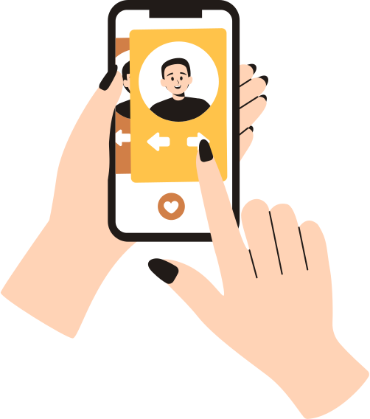






Design Opportunity & Audience
Audience
Design Opportunity
Younger travelers seek personalized, meaningful experiences and want to connect with like-minded individuals.
Young, Socially Connected Travelers
Seek unique, personalized travel experiences with a strong emphasis on social interaction.
social travel platform
Key Characteristics
Social Media Savvy: Active on platforms like Instagram and Weibo.
Event-Oriented: Plans trips around events, seeking companions for shared experiences.
Value for Shared Experiences: Prefers traveling with others who share their interests.
Collaborative Planners: Enjoys co-creating travel plans.
like-minded individuals
Initial concepts
Interest-Based Companion Matching
Event-Centered Itinerary Planning
Community Engagement
Notes:
We’ve identified a growing trend among travelers aged 18 to 35, who are moving away from traditional sightseeing towards more personalized and meaningful experiences. They are not just looking to visit new places; they want to share these experiences with like-minded individuals.To meet this demand, we are developing a social travel platform that connects users based on shared interests. Whether it’s attending a sports event, exploring local cuisine, or experiencing the culture of a destination, our platform will help users find companions who share these passions. Initial concepts Interest-Based Companion Matching: Helps users find travel companions with similar goals.
Event-Centered Itinerary Planning: Allows personalized travel plans around specific events.
Community Engagement: Fosters social interaction and collaborative trip planning.
Now, let’s talk about our target audience—young, socially connected travelers who are highly active on platforms like Instagram and Red. These individuals have a few key characteristics:
Social Media Savvy: They use social platforms to discover trends and connect with others who share their interests.
Event-Oriented: They often plan trips around specific events, looking for companions to join them in these experiences.
Value for Shared Experiences: They prioritize traveling with others who share their passions, enhancing the overall experience.
Collaborative Planners: They enjoy co-creating travel plans with others, valuing input from like-minded individuals.
In essence, our platform is tailored to meet the needs of these young travelers, providing them with the tools and community to create more personal, social, and fulfilling travel experiences. Thank you."

Slide 4
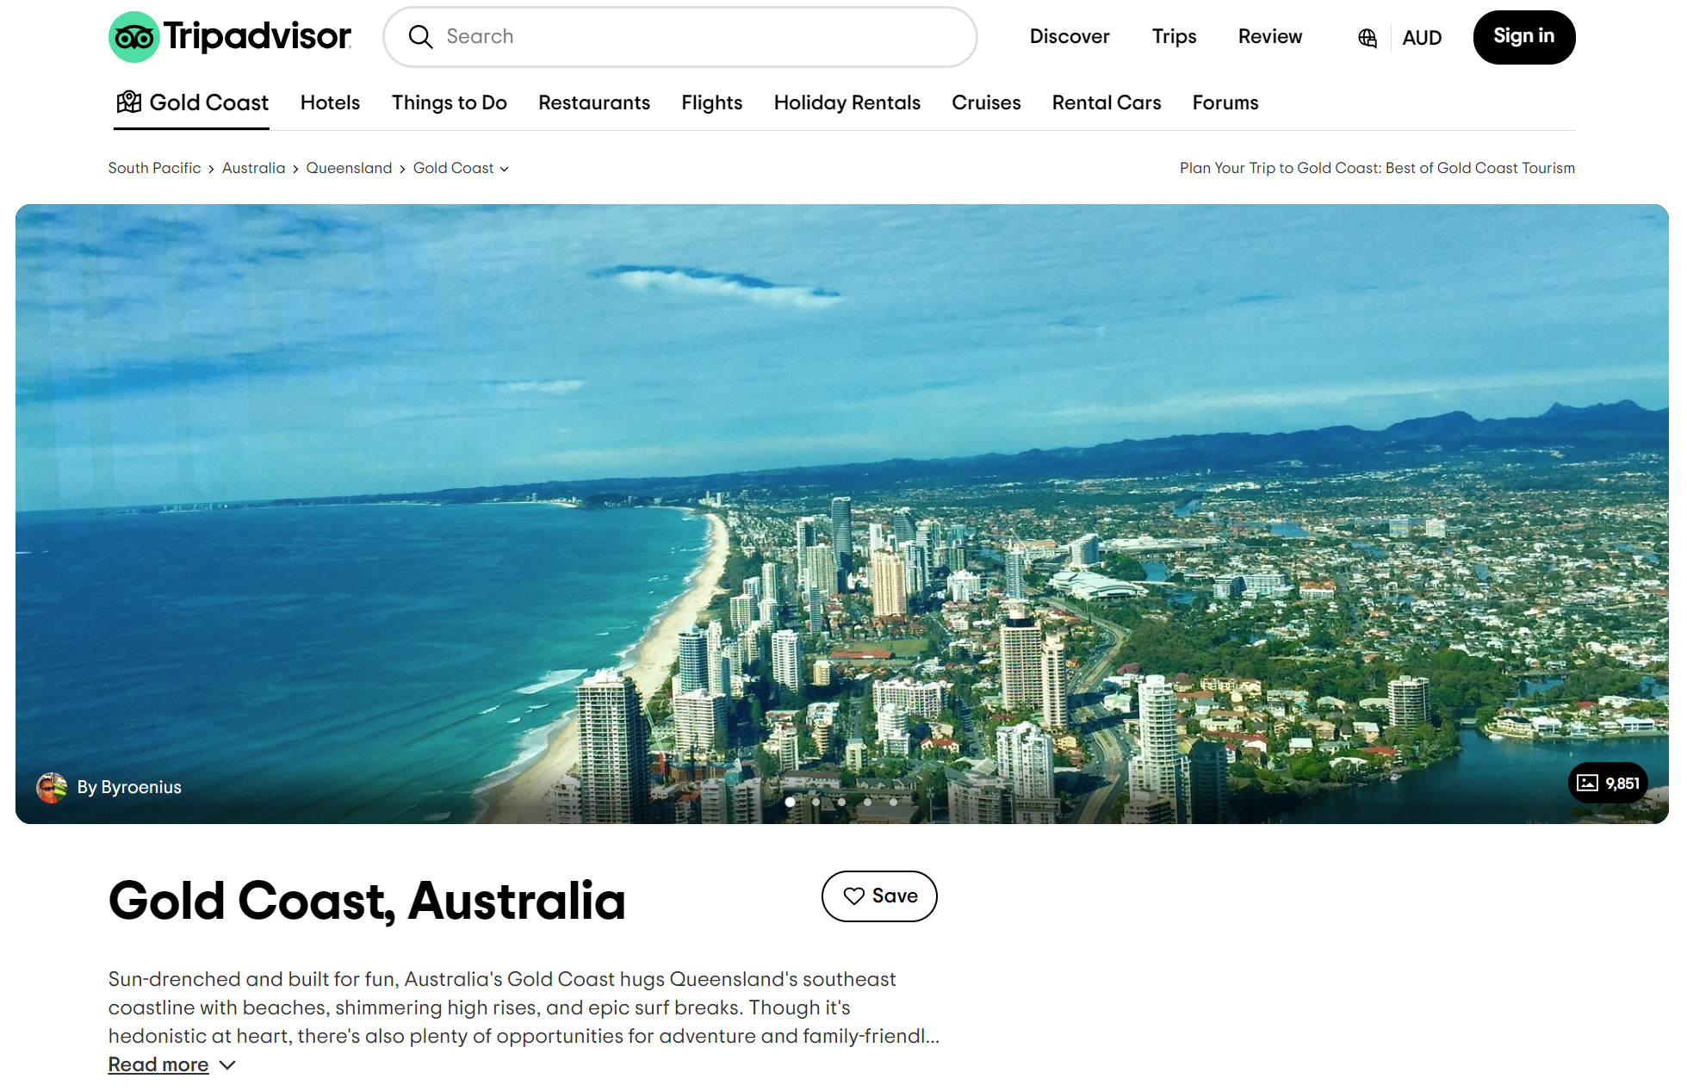
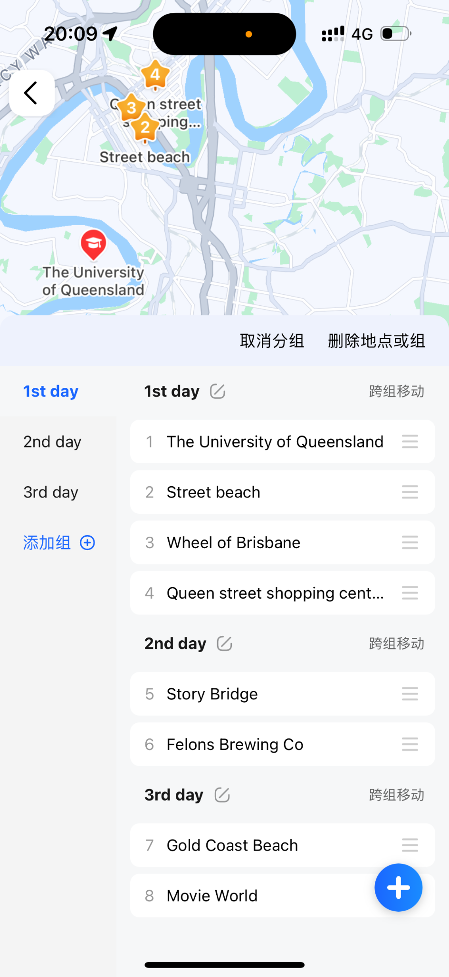
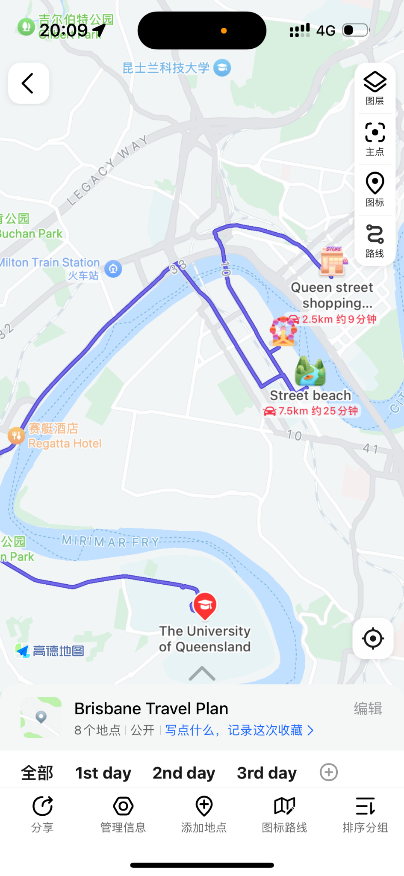
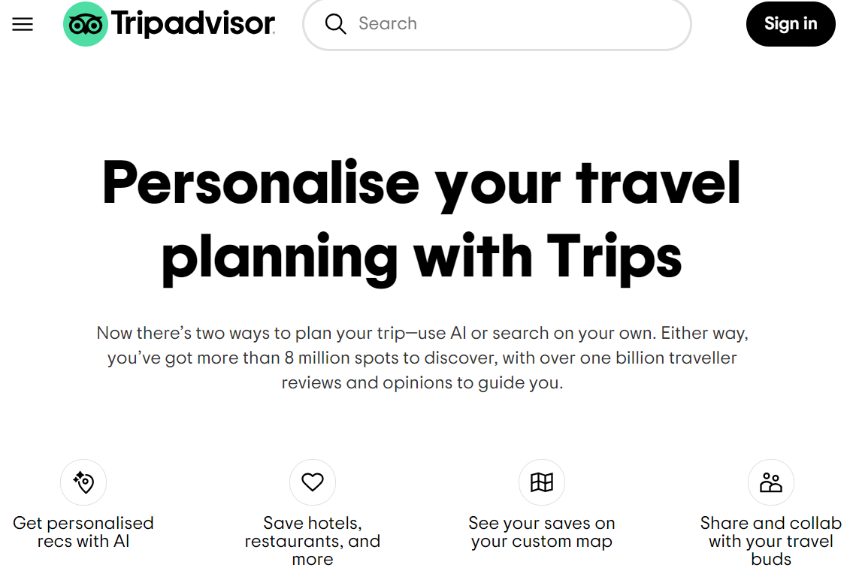
Previous attempts & A better/unique approach
Facing student groups/young people;
Transportation methods and travel time between destinations
A pretty perfect website:
Tripadvisor
Notes:
There's already a pretty perfect website for this—TripAdvisor. Once you enter a city or attraction, this site can recommend flights, hotels, activities, ticket bookings, and more, all in a one-stop service. Users just need to save their desired locations from the recommended list based on ratings and reviews to create a personalized travel itinerary, which can also be shared with others to plan together. This site even has an AI recommendation section, where users can generate travel plans with AI's help or expand on already saved itineraries when they’re out of ideas.
As a previous team member mentioned, our target users are university students or younger demographics, so our unique approach is more aligned with the characteristics and needs of this group. They tend to determine their travel destinations through social media, and their interests in attractions might be different. We will further explore their actual needs through subsequent interviews and other methods.
Regarding a better approach, TripAdvisor focuses more on long-distance travel between cities, so it primarily recommends flights for transportation. We also want to focus on short-distance travel within a city. As shown on this map, it highlights the recommended attractions along with the transportation options between them and the time required.

Slide 5
Work Plan & Method
Method: Research, Prototyping, User test
Deliverables - we are going to have implications from the user research, a collaborative prototype, high fidelity prototype
Design
&
Prototyping
Testing
&
enhancements
Research
About: Travelling preferences of Young people, How they plan their trips…
· Literature review
· Figma
· Testing with high-fidelity prototypes
· Interview
· Follow the design principles
(Nielsen Principles)
· Further understanding of user experience and interface usability
(Tourist attractions, Airports, Campus)
· Market Research
Week 6-7
Week 8-10
Week 10-11

